Slide 1

Improve ur Business with my Analysis
Capstone Project
By : Mo Amer.

Slide 2
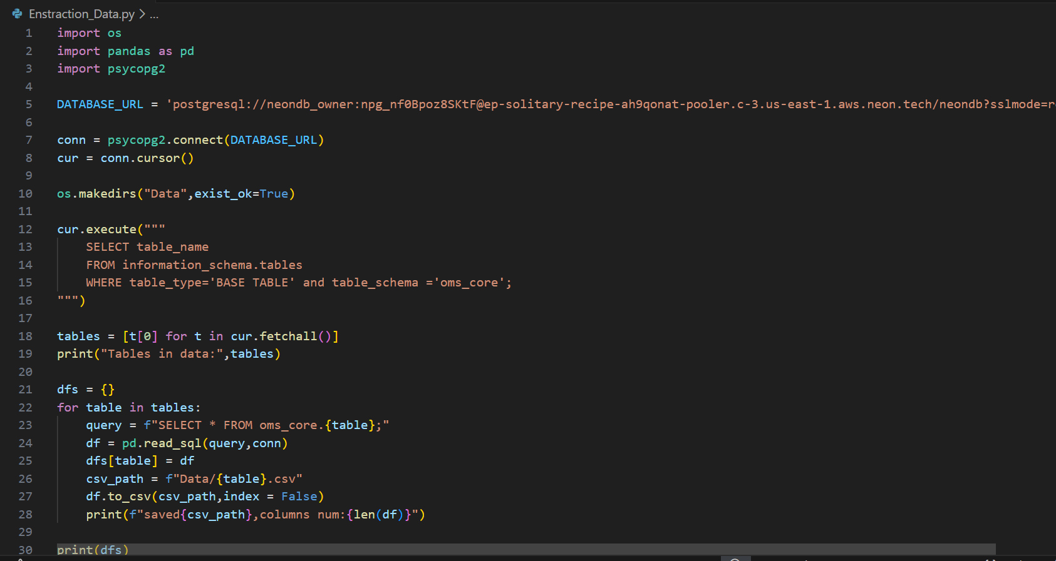
step1: Python Operations:
1. Extraction — Python → CSV:

Slide 3
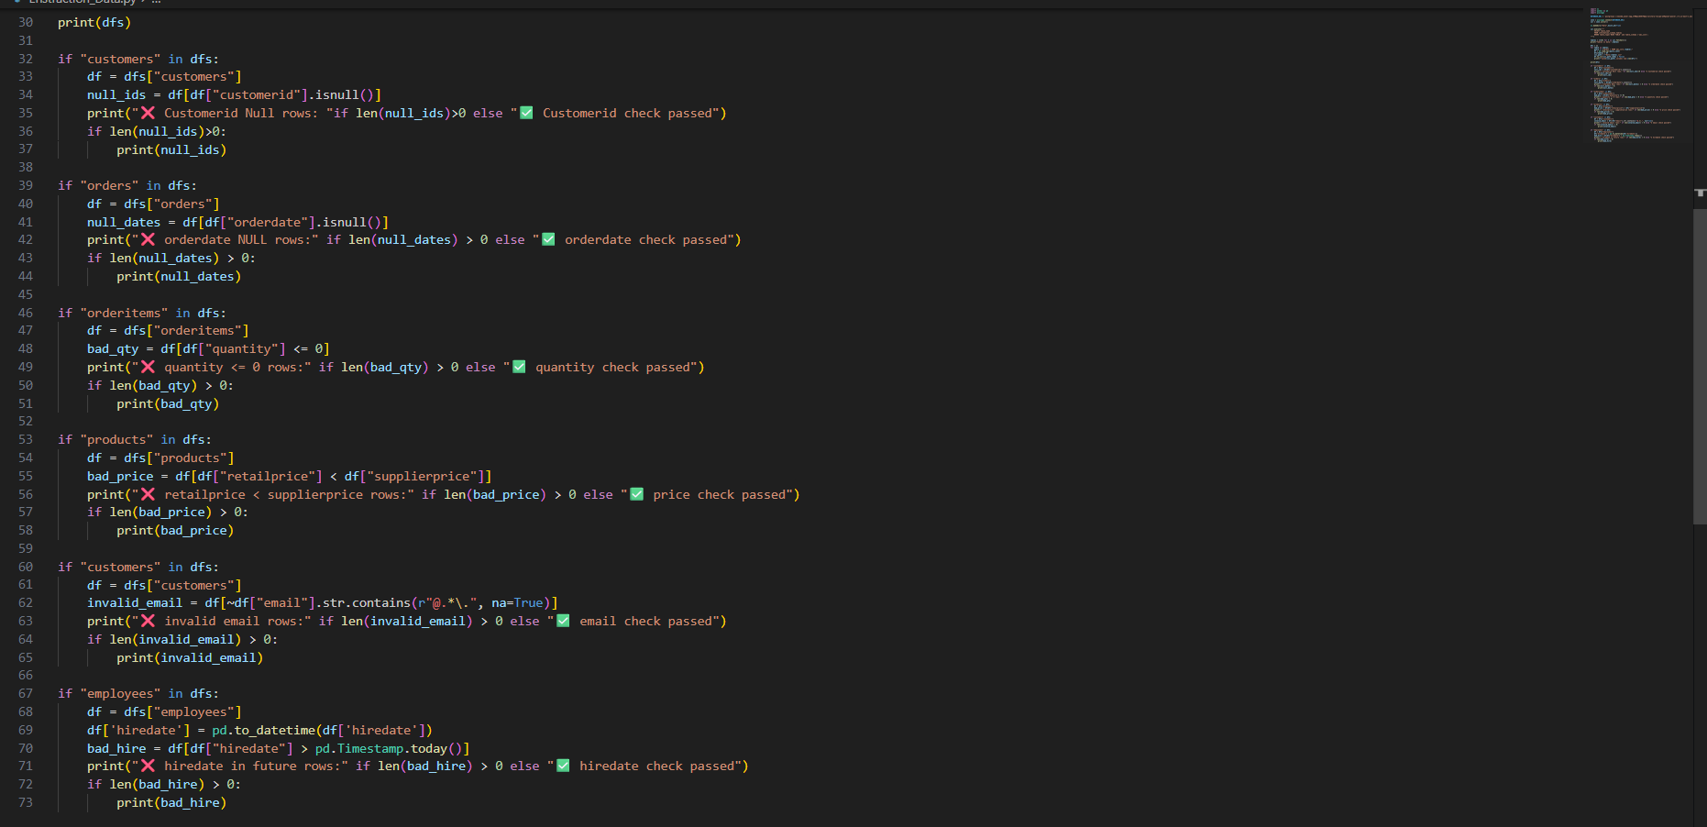
2.Data Quality Validation:

Slide 4
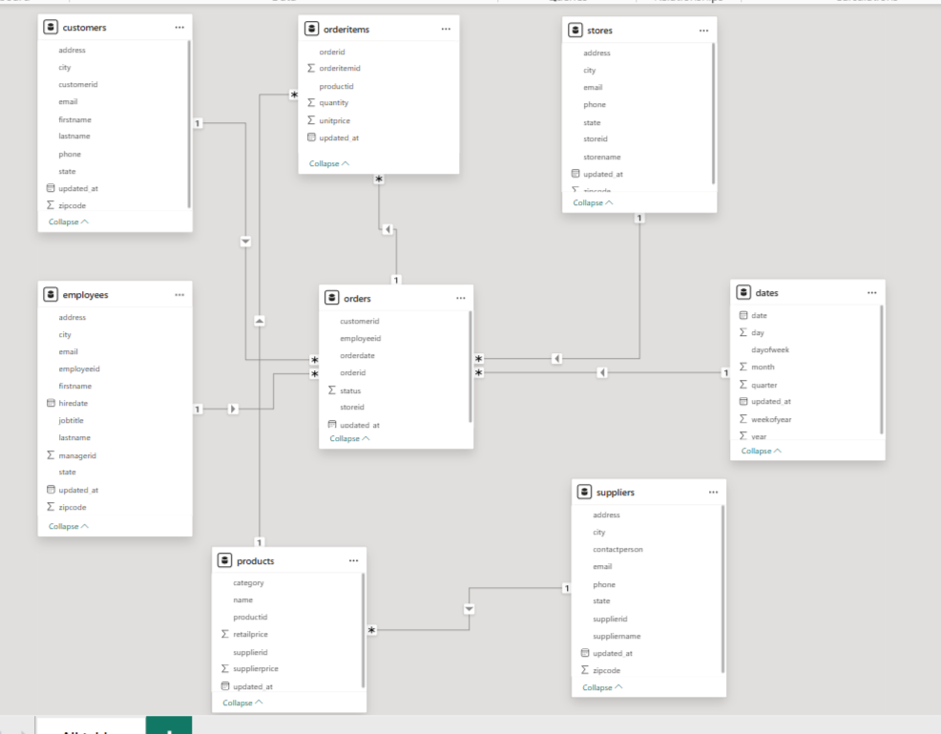
Step 2: Power bi Operations:
1. Data Model:

Slide 5
2. Create Business KPIs (DAX):
Total Orders
Average Order Value
Total Revenue
Cost
Profit
Gross Margin %
Repeat Customers

Slide 6
3.visualizations
Showing the important (KPIs)
Matrices
1. To clarifies top employees
2. To clarifies top products
3. To clarifies top customers
Line Chart
To clarifies Revenue by month
Bar chart
To clarifies Revenue by category
Donut chart
Revenue by store name
Slicers
To explain impact of any Employee, Customer, Product, and Date on your Business

Slide 7
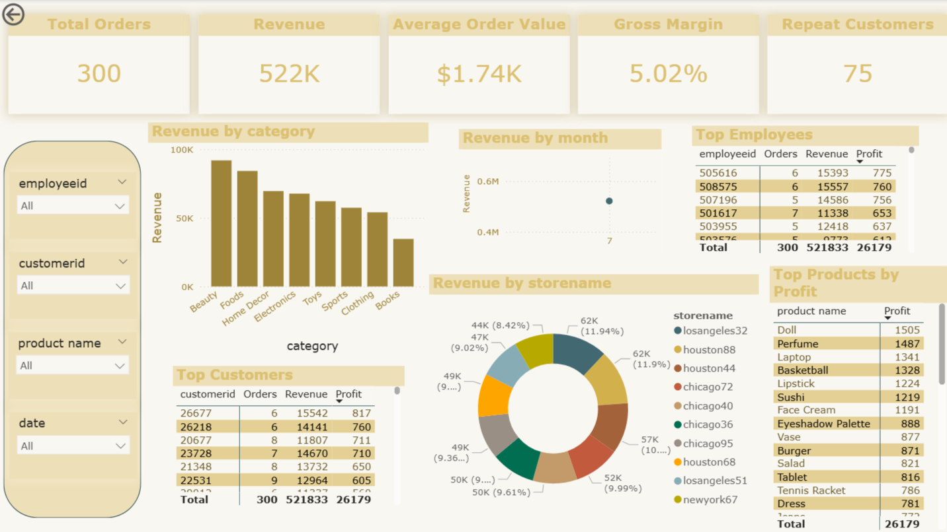

Slide 8
Click on this folder to open the documents of project

Slide 9

Thank u eng. Abdelhamid for ur effort with me

